Slide 1
Integer Programming Modeling

Slide 2
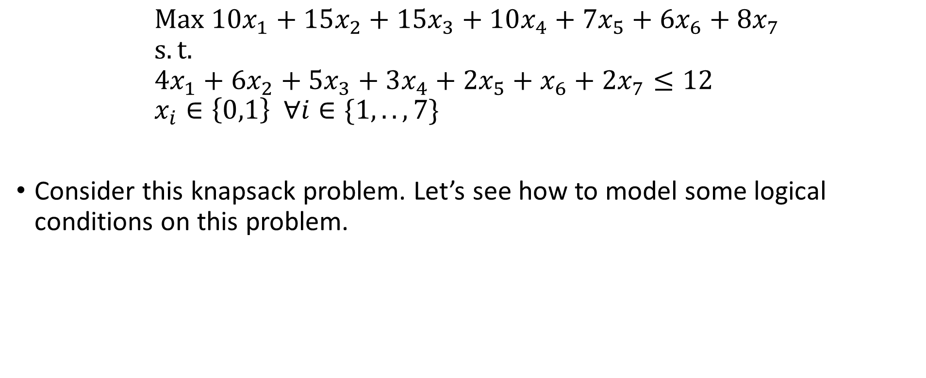
Example
$$Max {10x}_{1}+15x_{2}+15x_{3}+10x_{4}+7x_{5}+6x_{6}+8x_{7} \\ s.t. \\ 4x_{1}+6x_{2}+5x_{3}+3x_{4}+2x_{5}+x_{6}+2x_{7}≤12 \\ x_{i}∈\left\{0,1\right\} ∀i∈\{1,..,7\}$$
Consider this knapsack problem. Let’s see how to model some logical conditions on this problem.

Slide 3
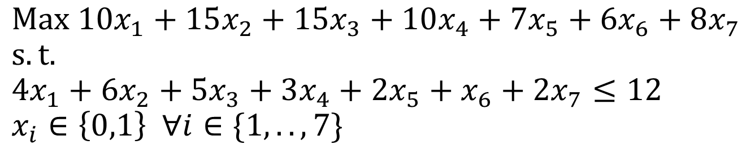
Logical Conditions
Either-Or
You can either select x₂ or x₃ but not both.
You can either select x₂ or x₃ or both.
If Conditions
You can only select x₃ if and only if you select x₄.
If x₁ is selected, then x₂ must be selected.
If x₁ is selected, then x₂ shouldn’t be selected.
You have to choose exactly k options.

Slide 4
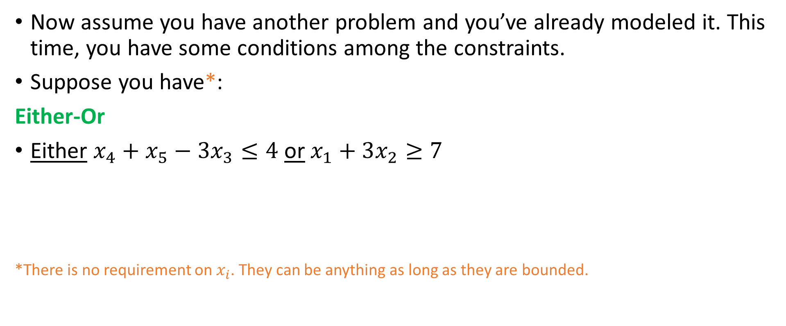
Logical Constraints
Now assume you have another problem and you’ve already modeled it. This time, you have some conditions among the constraints.
Suppose you have*:
Either-Or
Either $x_{4}+x_{5}−3x_{3}≤4$ or $x_{1}+3x_{2}≥7$
*There is no requirement on $x_{i}$. They can be anything as long as they are bounded.

Slide 5

Logical Constraints
If-Then
If $x_{4}+x_{5}−3x_{3}≤4$ then $x_{1}+3x_{2}≥7$

Slide 6
Fixed Cost
“If you build a school, you can have 1000 students.” This translates to:
“If you build a school, you must have at least 600 but no more than 1000 students.”
Notes:
If you heard “semi-continuous” variable, this is it (variable x)!

Slide 7

Some Linearization
Multiplication of Binary Variables
$z=xy$, x and y are binary

Slide 8

Some Linearization
Multiplication of a binary variable and a non-negative continuous variable
$z=xy$, x is a binary and y is a non-negative continuous variable

